Slide 1
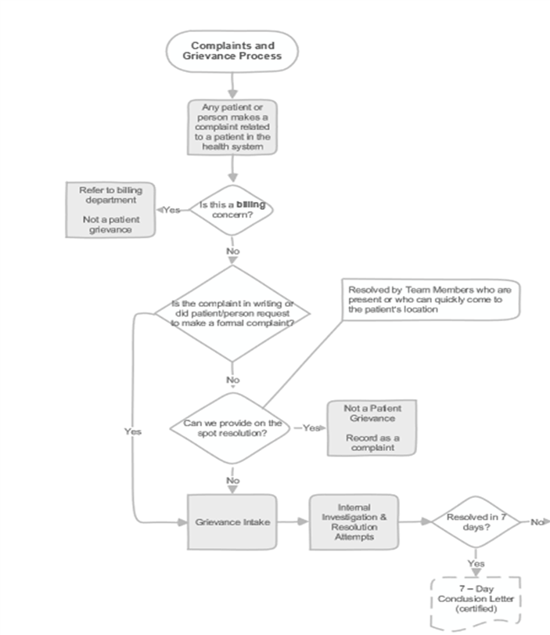
Service Recovery
What is it?
the steps and actions taken when the patients needs are not met
How do we address a concern? What if I do not know how to fix this issue? Who can I speak with to get help?

Slide 2
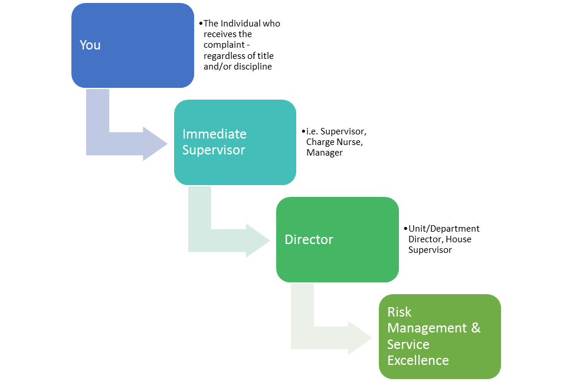
Who do I go to??
Service recovery is the responsibility of every MCHS Team Member. Any MCHS team member who is first to hear or see a complaint, concern, or need, is empowered, and expected, to begin the Service Recovery process immediately by apologizing and begin the process of working to correct the perceived problem.
Risk management or
patient advocate

Slide 3
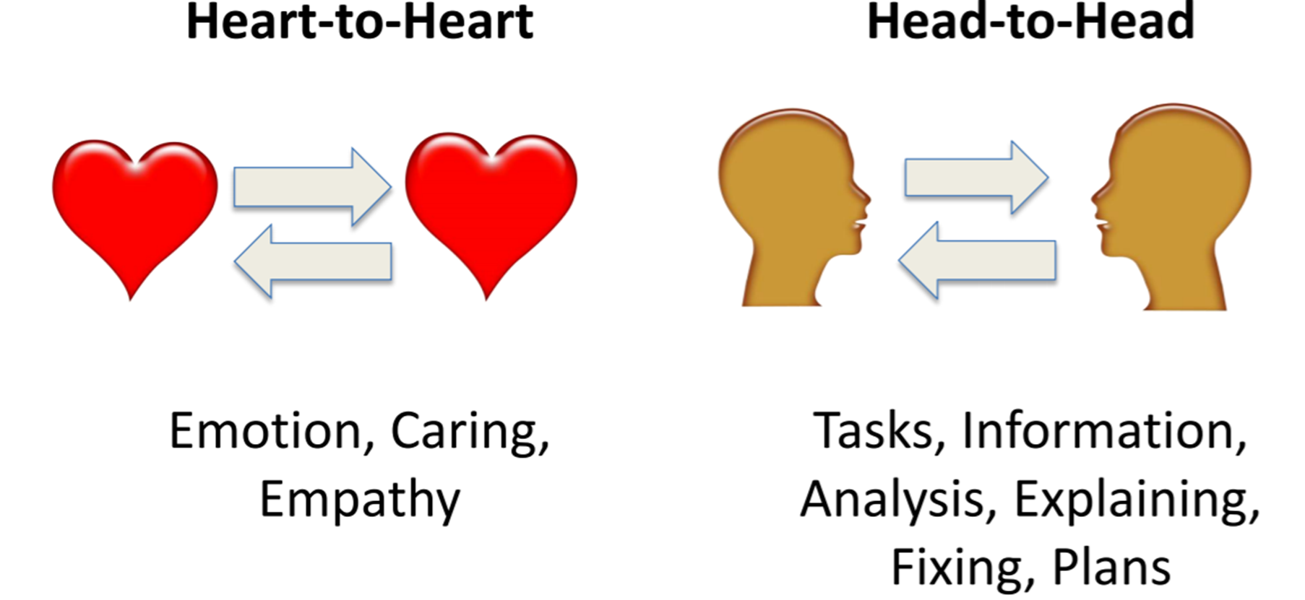
Heart-Head-Heart Communication Model
Head-Head
Heart-Heart
Valuable information
Answers & solutions
Feel important and understood
Can understand head-to-head communication better

Slide 4
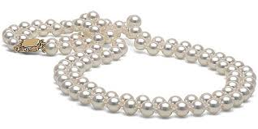
PEARLS
PEARLS phrases:
Partnership: “Let’s work on this together.”
Empathy: “I can imagine from what you’re saying how difficult a time this has been for you.”
Apology: “You’ve been waiting an hour to see me; I’m really sorry you had to wait so long.”
Respect: “I can see you’ve thought this out very carefully by the amount of research you’ve done on the issue.”
Legitimize: “Anyone in your situation would feel that way.”
Support: “I’ll be with you all the way.”

Slide 5
MCHS Service Recovery process
R – Recognize Concern
E – Empathize
A – Apologize
C – Connect & Listen
T – Take Action

Slide 6
Recognize Concern
Acknowledge there is a concern when one is voiced
Look for non-verbal cues (tone of voice; body language)
Don’t be afraid to ask questions

Slide 7
Empathize
The ability to understand and share the feelings of another.
See it through their eyes
Try to understand the thoughts, feelings and emotions they are experiencing.
Let the patient/visitor know you “get it”

Slide 8
Apologize
DO’s of an apology
Use warm, open body language
Make eye contact
Use your “soft” voice
Use “I” statements
Don’ts of an apology
X Use a defensive tone of voice
X Argue
X Smile inappropriately
X Sound like a robot
Be sincere & make eye contact
“I’m sorry this has happened…” “I apologize for your frustration…”

Slide 9
Connect & Listen
Stop and focus on the patient/visitor
Listen patiently and non-defensively
Try to sit down with the patient to give your full attention and time
Ask open-ended questions

Slide 10
Take Action
Take ownership of the resolution
Explain available options, if appropriate
Involve the patient/visitor in the resolution process
Follow Through!!!

Slide 11
It’s not Our Journey…
It’s the patients’ and families’
Ideal Journey is…
Safe, Secure, Extraordinary.

Slide 12
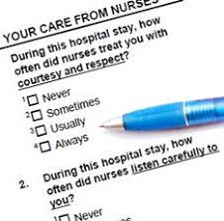
Did you know?
A satisfied patient tells 1-5 people about their experience. A dissatisfied customer tells 10-20 people about their experience.
Keeping customers satisfied and providing service recovery when necessary, keeps patients and others coming back.

Slide 13
Feedback is Valuable and Appreciated.. Welcome it!
Feedback from our patients is valuable as we review our processes and strive to improve the care and service that we provide.
How do we receive feedback?
HCAHPS and CG CHAPS Survey
Press Ganey Patient Experience Surveys
Patient Experience Hotline (2273)
Front Line Team Members

Slide 14
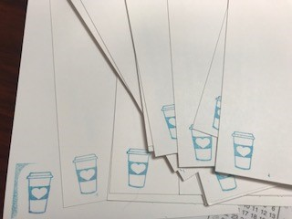
We love to hear when you are providing excellent service!
ICARE cards are an employee recognition program that is used to recognize employees that are providing excellent service and service recovery.
ICARE cards are on every unit and in all areas of the hospital
Some ICARE cards are stamped – If a stamped ICARE card is filled out for you, Service Excellence will find you with a Starbucks gift card!

Slide 15
Customers do not expect us to be perfect, but as healthcare professionals they do expect us to fix things when they go wrong. How we respond once we know about an issue can turn even a very unpleasant experience into a positive one.

